Slide 1
RUM Community Group
2025-01-17 Edition

Slide 2
Agenda
Greetings from the Chairs
Welcome everyone to the group
+ a quick round of intros
Logistics (where and how to communicate)
Goals and Meeting Topics for 2025

Slide 3



Greetings from Chairs

Slide 4
Role of Chairs
Plan meetings and agenda
+ with input from everyone here!
Facilitate meetings + discussions
Build consensus
Communicate externally
Not arbitrators of what's important

Slide 5


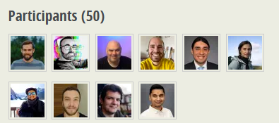

Vision of RUM CG
"Please implement X" "We're having a problem with Y"
"Can we get traction on Z?"
"We're changing X" "Heads-up for Y"
"New experimentation with Z"
"Please start or stop X"
CDNs
Third-Parties (3Ps)
discuss +
help each
other
"What are your use cases for X?"
"How often does Y affect you?"
"Would Z solve your problem?"
"Solving this problem would help"
"Here are the most important things to us"
"We'd like to propose X"

Slide 6
Welcome / Intros
Brief introduction:
‘Who are you?’
‘Where ya from?’
‘What would you say you do here?’

Slide 7
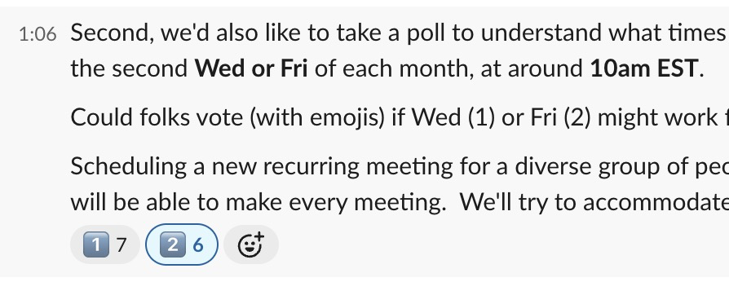
Logistics
When should we meet and how often? (Poll)
Daily? Monthly?
30-60m?
Wednesday or Friday?
~10am EST
Agenda Document
(bit.ly/rumcg-agenda)
Google Meet for Meetings
(invites)
Chat on Web Performance Slack #w3c-rum-community-group
(invites)
public-rumcg@w3.org

Slide 8
Goals / Meeting Topics (Ideas)
What do we want to work on together?
Tracking progress/positions by browser vendors
Feature funding for browsers (i.e. getting stuff done in webkit)
Header adoption (TAO, Server-timing)
Browser vendor presentations/Q&A
Collective outreach to move the needle on performance (i.e. 3rd Parties, CDNs)
Engaging with AdBlockers & Tracking protection (CMPs?)
Top tracking issues (e.g. in Github)
What else????

Slide 9



Barry's Bytes
Cross-origin LCP render time will no longer be gated on Timing-Allow-Origin. Sites may notice a change in their LCP in RUM. Note CrUX not affected as always measured this properly, and TAO still required for Firefox and older Chromes.
responseStart is changing back thereby changing TTFB for sites using Early Hints to be the finalResponseHeadersStart. Note CrUX unaffected as never changed definition.
5 minute prefetch heuristic has been removed for cache-control: no-store or max-age: 0. You now MUST use cache-control header if you want to use prefetch (note speculation rules has an exception as it has a different 5 minute rule). Sites may notice prefetch is used less.
Other small updates.

Slide 10
Next Meeting
2nd Wed or Friday of each month
Wed February 12th @ 10am EST
Fri February 14th @ 10am EST
Topic: Google + RUM Sync
Homework: ???

